Slide 1
Logic Design 1st Term Project
-Double digit BCD calculator-
TA: 최승훈 E-mail: csh30096@korea.ac.kr
SoC & Microprocessor Research Laboratory

Slide 2
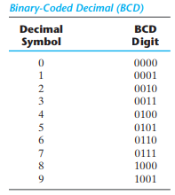
Double digit BCD calculator
BCD(Binary Coded Decimal)
Decimal 36 is represented in BCD with 8 bits as 0011 0110, with each group of 4 bits representing one decimal digit.
Notes:
비헤이비어럴(Behavioral) 레벨 모델링
Initial 구문
- 시간은 0에서 시작
- 시뮬레이션에서 한번만 수행
- initial 블록이 여러 개일 경우 동시에 수행
- initial 블록 안에 여러 문장이 있는 경우 begin end로 묶어 줌

Slide 3
Double digit BCD calculator
Scenario
Input
Input1: 1bit (SW[16], operator)
Available Operation: + (0), - (1)
Input2: 4bit (SW[15:12], data_in1)
Input3: 4bit (SW[11:8], data_in2)
Input4: 4bit (SW[7:4], data_in3)
Input5: 4bit (SW[3:0], data_in4)
Output
Output1: 7bit (HEX7[0:6], data_out1)
Output2: 7bit (HEX6[0:6], data_out2)
Output3: 7bit (HEX5[0:6], data_out3)
Output4: 7bit (HEX4[0:6], data_out4)
Output5: 7bit (HEX1[0:6], result_out1)
Output6: 7bit (HEX0[0:6], result_out2)
Output7: 1bit (LEDG8, overflow_underflow)

Slide 4
Double digit BCD calculator
Input2_Input3 (operate(Input1)) Input4_Input5 = Output5_Output6
Ex 1) 74 + 13 = 87
Input2(SW[15:12]) = 7(0111), Input3(SW[11:8]) = 4(0100)
Input4(SW[7:4]) = 1(0001), Input5(SW[3:0]) = 3(0011)
Input1(SW[16]) = 0 (+)
Output1(HEX7) = 7 (7’b000_1111)
Output2(HEX6) = 4 (7’b100_1100)
Output3(HEX5) = 1 (7’b100_1111)
Output4(HEX4) = 3 (7’b000_0110)
Output5(HEX1) = 8 (7’b000_0000)
Output6(HEX0) = 7 (7’b000_1111)
Output7(LEDG8) = 0 (Overflow, Underflow X)

Slide 5
Double digit BCD calculator
Input2_Input3 (operate(Input1)) Input4_Input5 = Output5_Output6
Ex 1) 13 – 74 = underflow
Input2(SW[15:12]) = 1(0001), Input3(SW[11:8]) = 3(0011)
Input4(SW[7:4]) =7(0111), Input5(SW[3:0]) = 4(0100)
Input1(SW[16]) = 1 (-)
Output1(HEX7) = 1 (7’b100_1111)
Output2(HEX6) = 3 (7’b000_0110)
Output3(HEX5) = 7 (7’b000_1111)
Output4(HEX4) = 4 (7’b100_1100)
Output5(HEX1) = X (7’b111_1111)
Output6(HEX0) = X (7’b111_1111)
Output7(LEDG8) = 1 (Underflow)

Slide 6
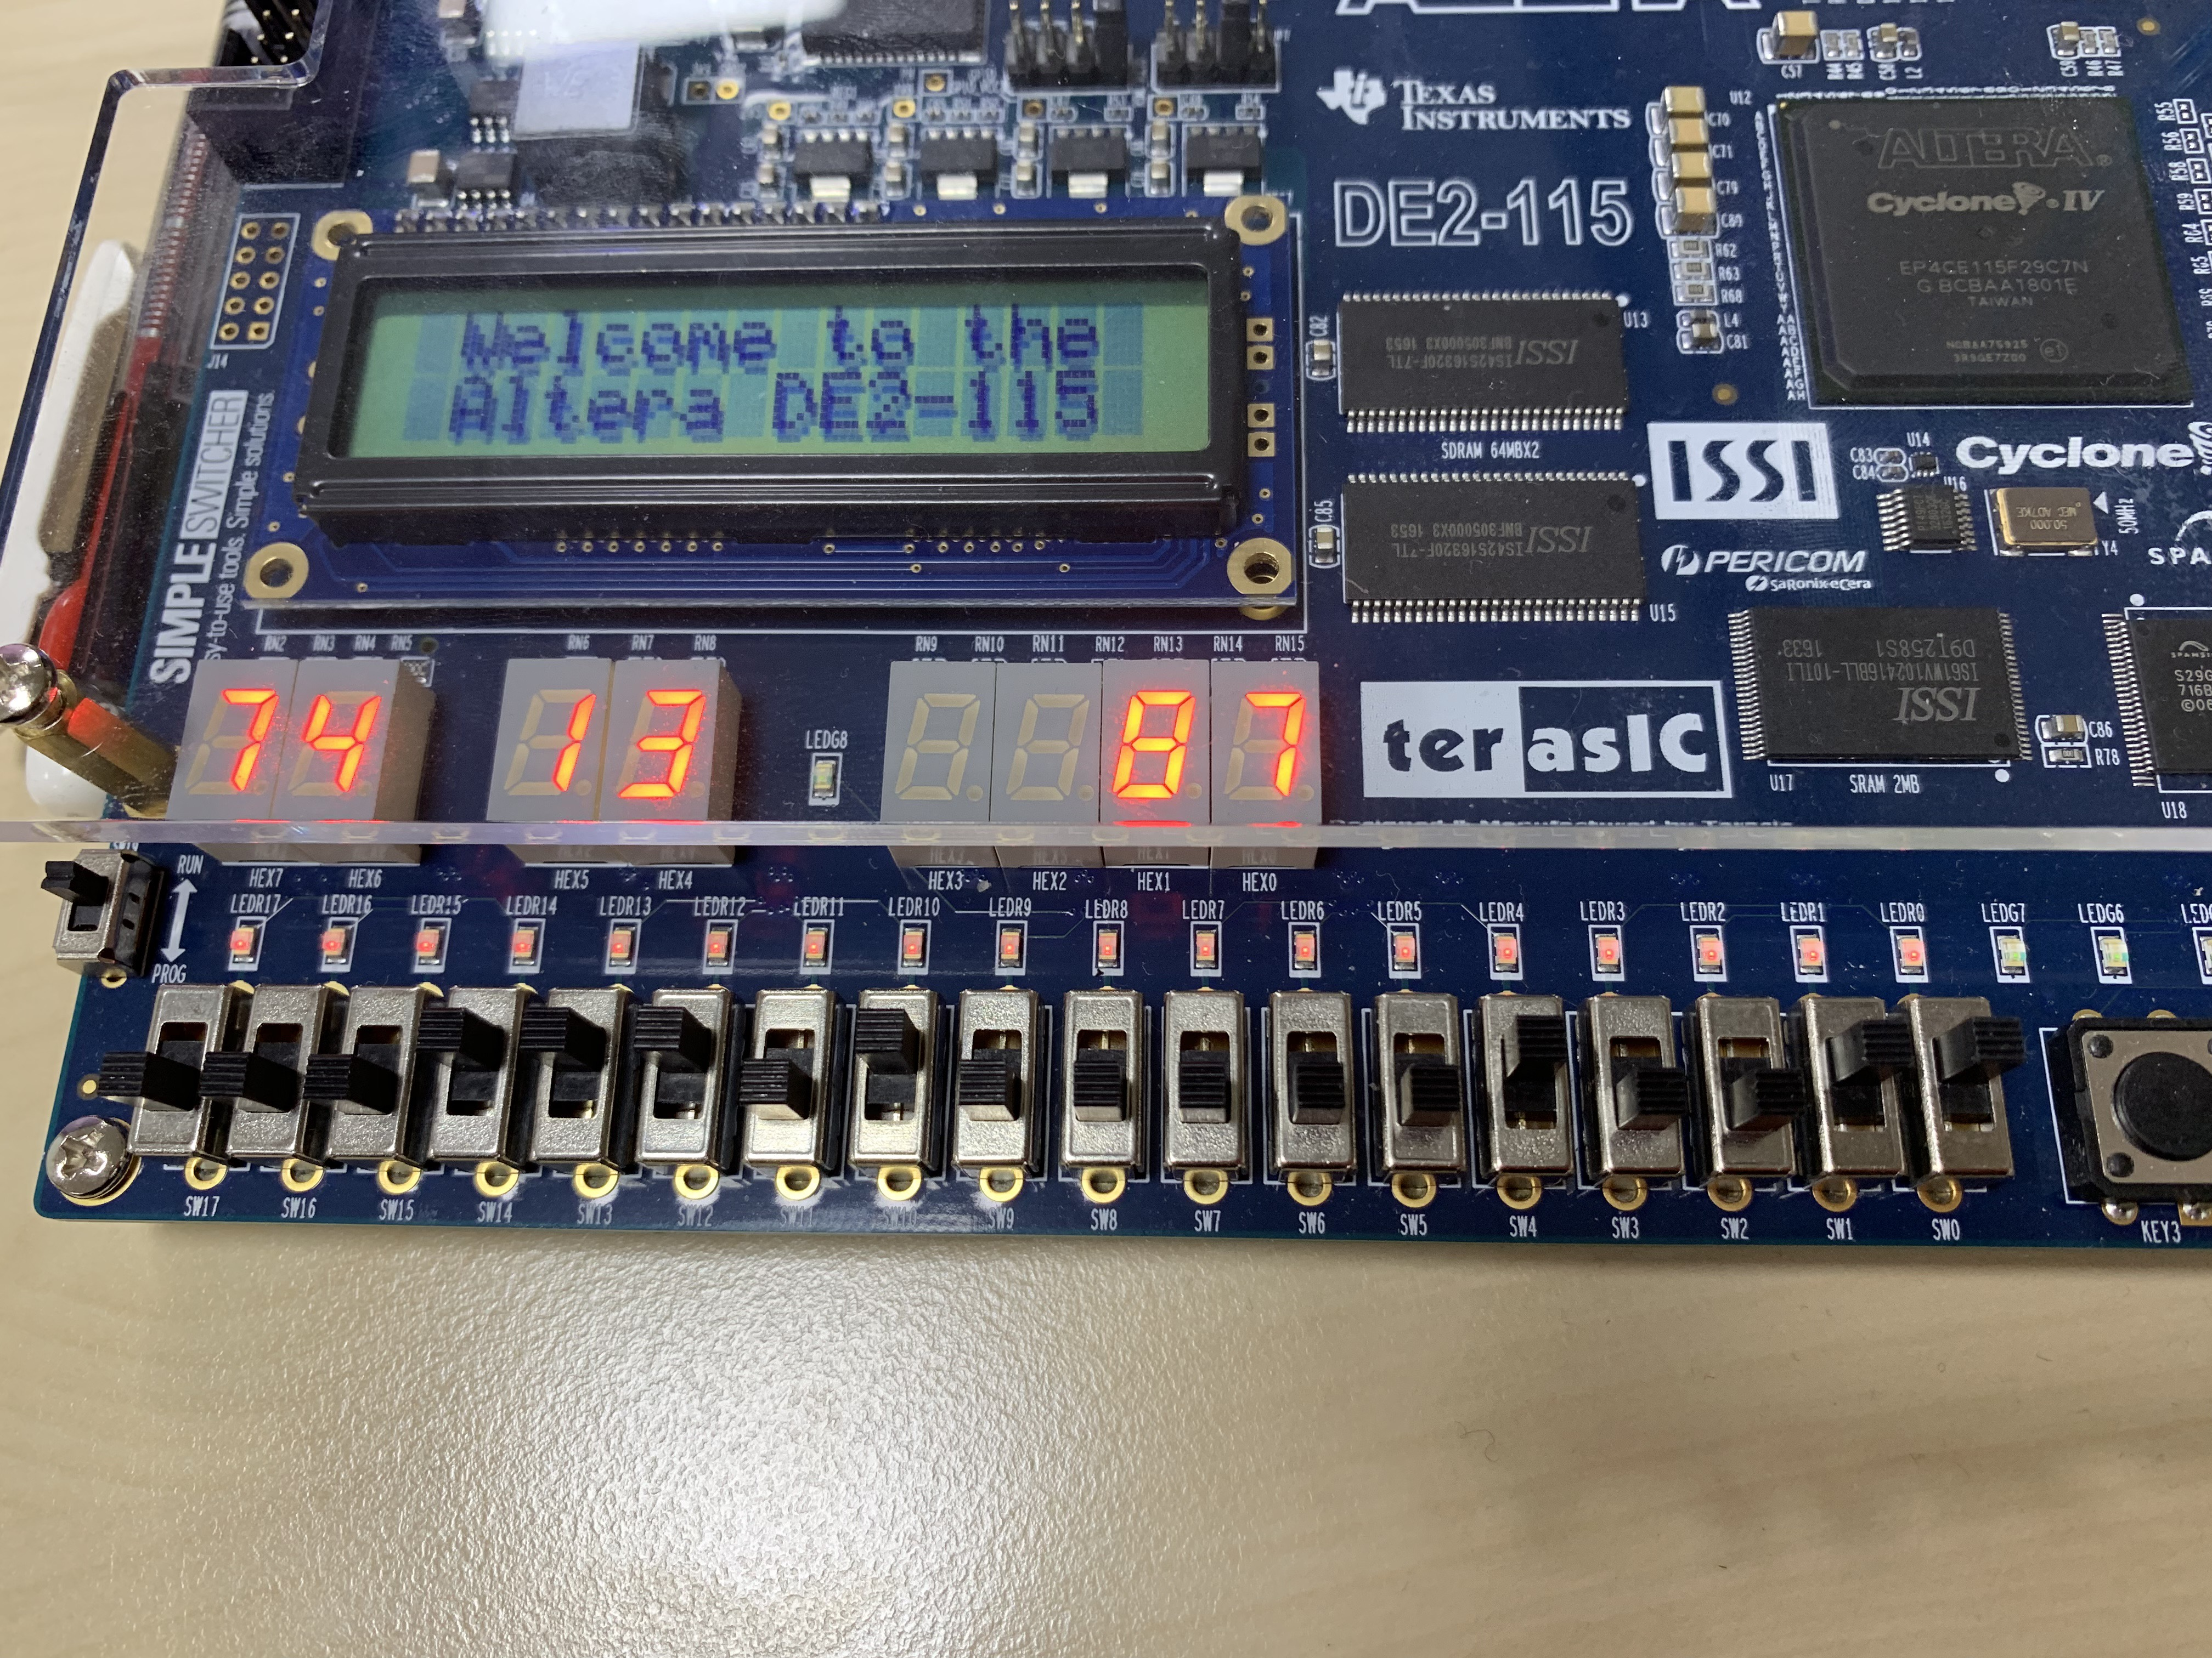
Double digit BCD calculator
Result Example
74+13=87
74+13 = 87
Input1
0 (+)
Input2
0111
Input3
0100
Input4
0001
Input5
0011

Slide 7
Double digit BCD calculator
Due Date: ~2019. 04. 12 15:29:59 – 데드라인까지 메일 보내야됨.
Check Time: 2019.04.12 15:30 (room 202).
If you submit after the deadline, you will get zero point. (no point)
IF YOU TRY TO COPY&PASTE, YOU and YOUR FRIEND WILL GET “F”
Project (10 points)
Report (2 points)
Project Summary (0.5 points) – 프로젝트 구현 방식 설명
Simulation Screenshot (0.5 points) – 시뮬레이션 사진
HDL code (annotation should be included) (0.5 points) – 코드 복붙 + 주석
Troubleshooting process (0.5 points) – 과제중 생긴 문제나 어려운점과 해결과정
Result (8 points)
Add (2 points)
Subtract (2 points)
Overflow (2 points)
Underflow (2 points)
Compress your Quartus VerilogHDL file(.v) and report to StudentID_Name(eng).zip, and send an e-mail to TA(csh30096@korea.ac.kr).
Notes:
비헤이비어럴(Behavioral) 레벨 모델링
Initial 구문
- 시간은 0에서 시작
- 시뮬레이션에서 한번만 수행
- initial 블록이 여러 개일 경우 동시에 수행
- initial 블록 안에 여러 문장이 있는 경우 begin end로 묶어 줌

Slide 8
4bit Full Adder Example Code
module midterm( input [7:0] SW, output reg [0:6] HEX0,HEX6,HEX4 );
reg [3:0] bit2, bit3;
wire [3:0] bit1;
wire car_1;
reg car_0;
parameter Seg9 = 7'b000_1100; parameter Seg8 = 7'b000_0000; parameter Seg7 = 7'b000_1111; parameter Seg6 = 7'b010_0000; parameter Seg5 = 7'b010_0100;
parameter Seg4 = 7'b100_1100; parameter Seg3 = 7'b000_0110; parameter Seg2 = 7'b001_0010; parameter Seg1 = 7'b100_1111; parameter Seg0 = 7'b000_0001;
full_adder fulladd (bit1, car_1, bit2, bit3, car_0); // Create Module fulladd
always @(*)
begin
bit2 = SW[7:4];
bit3 = SW[3:0];
car_0 = 1'b0;
end
always @(*)
begin
case(SW[7:4])
9:HEX6=Seg9; 8:HEX6=Seg8; 7:HEX6=Seg7; 6:HEX6=Seg6;
5:HEX6=Seg5; 4:HEX6=Seg4; 3:HEX6=Seg3; 2:HEX6=Seg2;
1:HEX6=Seg1; 0:HEX6=Seg0; default: HEX6 = 7'b1111111;
endcase
case(SW[3:0])
9:HEX4=Seg9; 8:HEX4=Seg8; 7:HEX4=Seg7; 6:HEX4=Seg6;
5:HEX4=Seg5; 4:HEX4=Seg4; 3:HEX4=Seg3; 2:HEX4=Seg2;
1:HEX4=Seg1; 0:HEX4=Seg0; default: HEX4 = 7'b1111111;
endcase
case(bit1)
9:HEX0=Seg9; 8:HEX0=Seg8; 7:HEX0=Seg7; 6:HEX0=Seg6;
5:HEX0=Seg5; 4:HEX0=Seg4; 3:HEX0=Seg3; 2:HEX0=Seg2; 1:HEX0=Seg1; 0:HEX0=Seg0; default: HEX0 = 7'b1111111;
endcase
end
endmodule
module full_adder(sum, car, a, b, cin);
output [3:0] sum;
output car;
input [3:0] a, b;
input cin;
wire [2:0] c;
assign sum[0]=a[0] ^ b[0] ^ cin;
assign c[0]=((a[0] ^ b[0]) & cin) | (a[0] & b[0]);
assign sum[1]=a[1] ^ b[1] ^ c[0];
assign c[1]=((a[1] ^ b[1]) & c[0]) | (a[1] & b[1]);
assign sum[2]=a[2] ^ b[2] ^ c[1];
assign c[2]=((a[2] ^ b[2]) & c[1]) | (a[2] & b[2]);
assign sum[3]=a[3] ^ b[3] ^ c[2];
assign car=((a[3] ^ b[3]) & c[2]) | (a[3] & b[3]);
endmodule

Slide 9
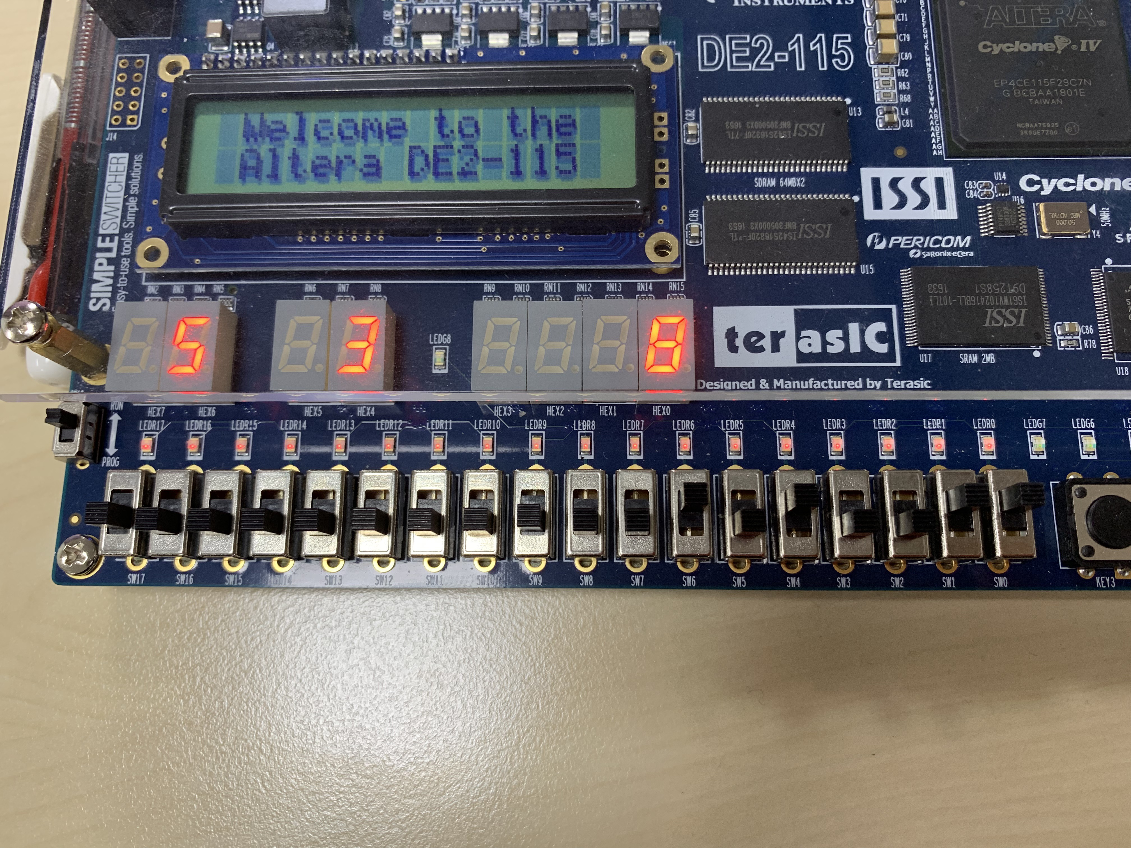
4bit Full Adder Example Code
Result Example
5+3=8
5+3=8
SW[7:4]
0101
SW[3:0]
0011

Slide 10
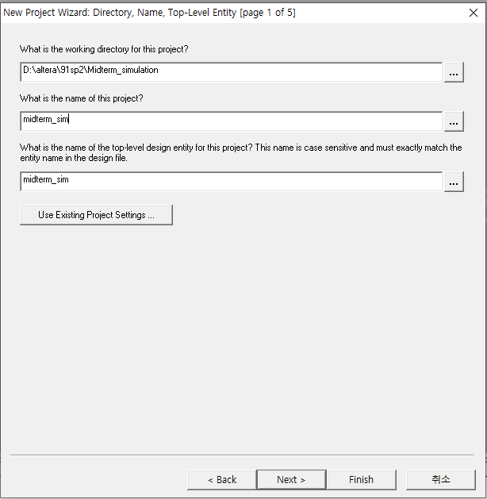
Simulation
Open a new project

Slide 11
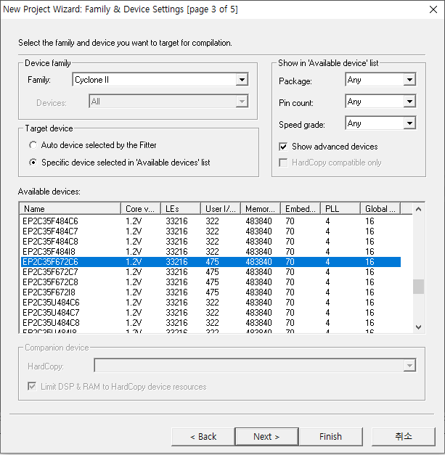
Simulation
Device – Cyclone II EP2C35F672C6

Slide 12
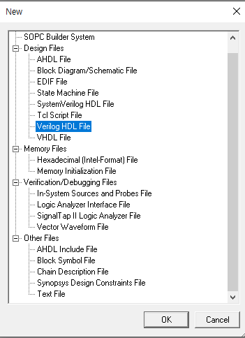
Simulation
File -> new -> Verilog HDL File

Slide 13
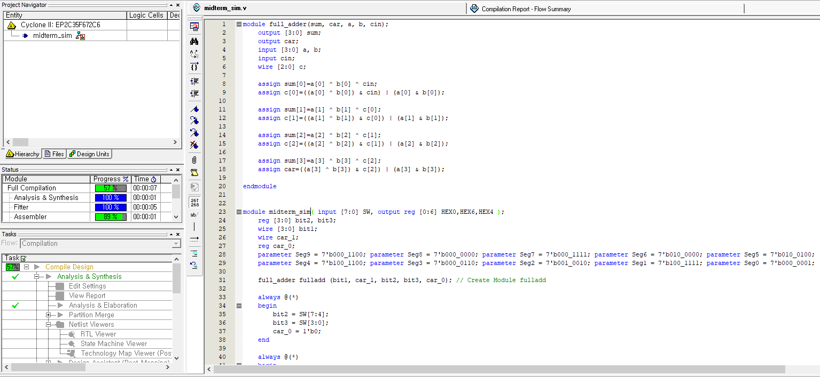
Simulation
Code Copy & Paste -> Save the VerilogHDL File -> Start Compile
Note the module name

Slide 14
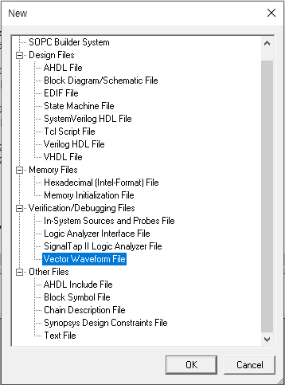
Simulation
File -> new -> Vector Waveform File

Slide 15
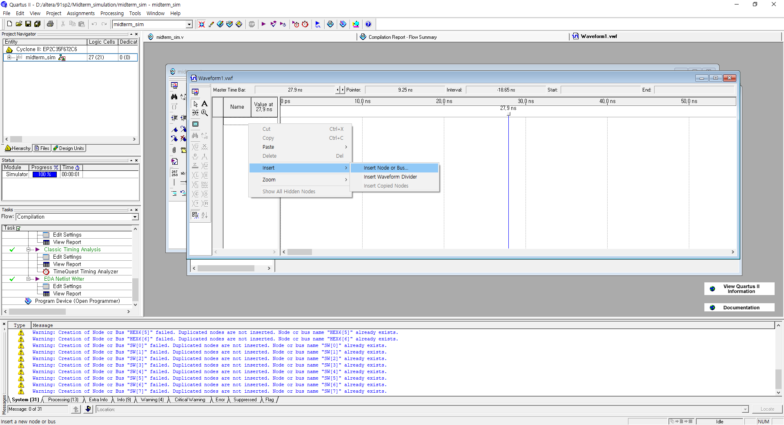
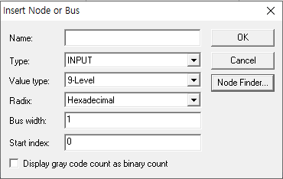
Simulation
Right Mouse Click -> Insert -> Insert Node or Bus.. -> Node Finder

Slide 16
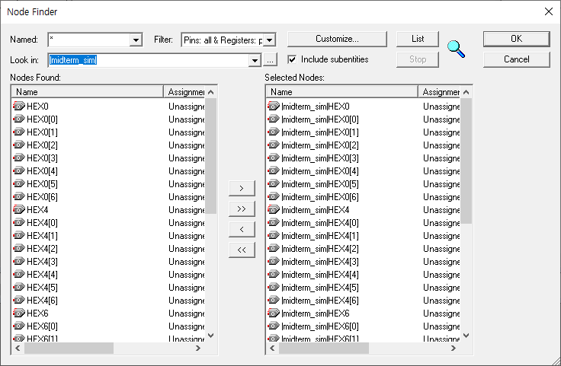
Simulation
List -> Select Nodes -> OK -> OK
1
4
2
Select !
3

Slide 17
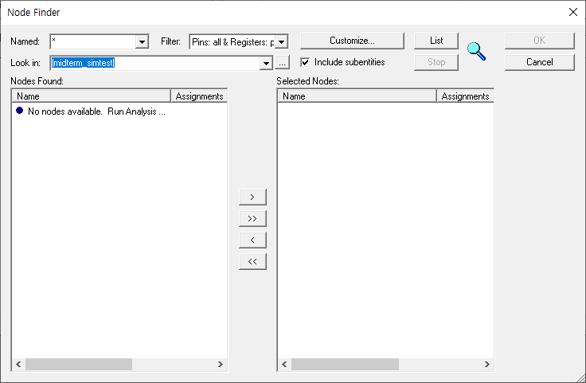
Simulation
If not synthesized, the following screen will be displayed.

Slide 18
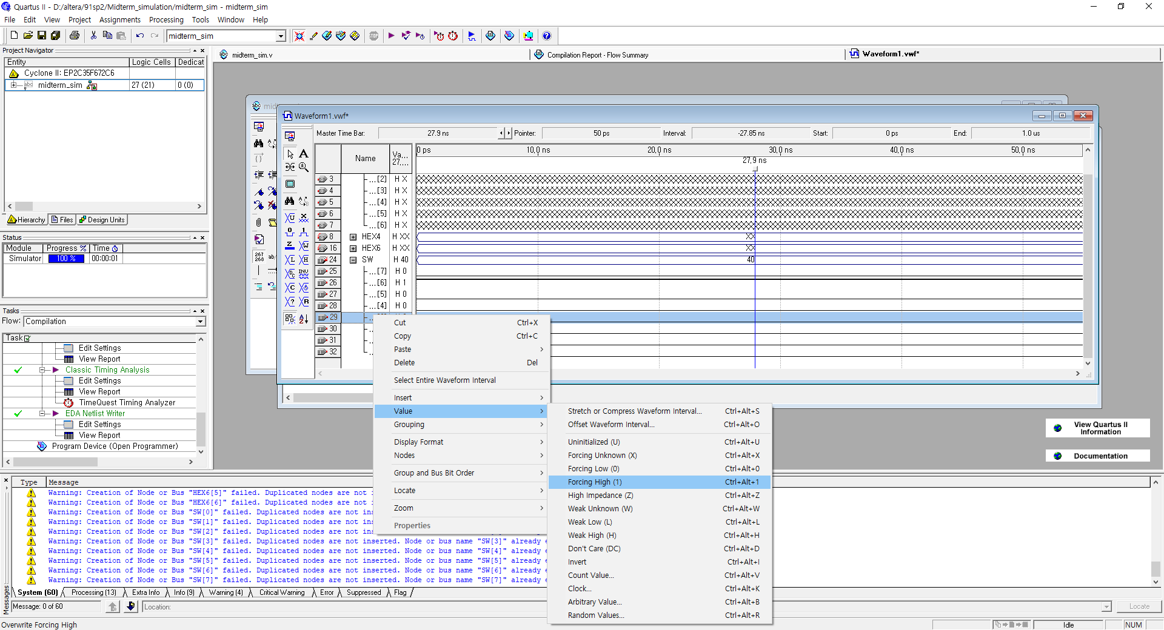
Simulation
Select SW -> Right Mouse Click -> Value -> Forcing High(1) or Low (0) -> Save the Waveform file in your simulation project folder

Slide 19
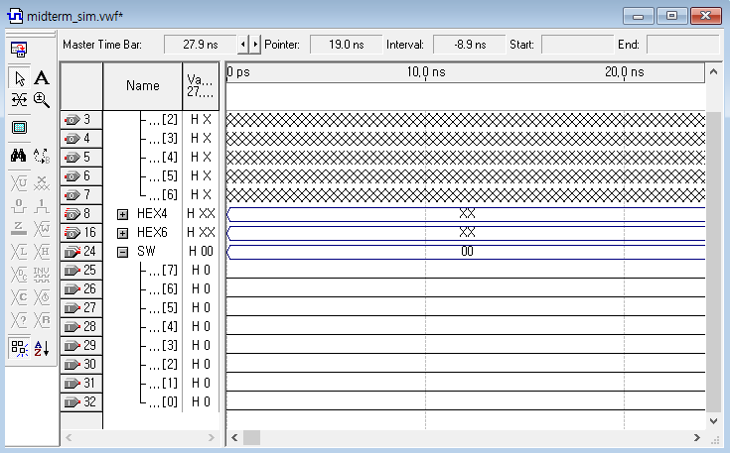
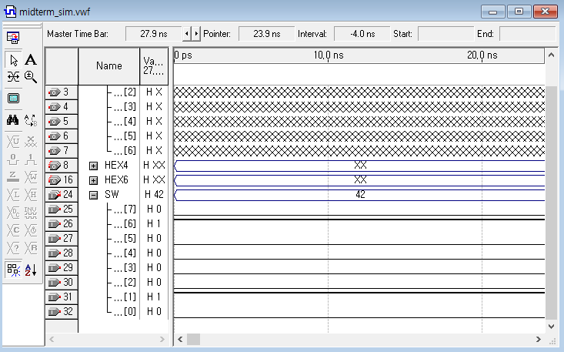
Simulation
After change the value of SW[6], SW[1]

Slide 20
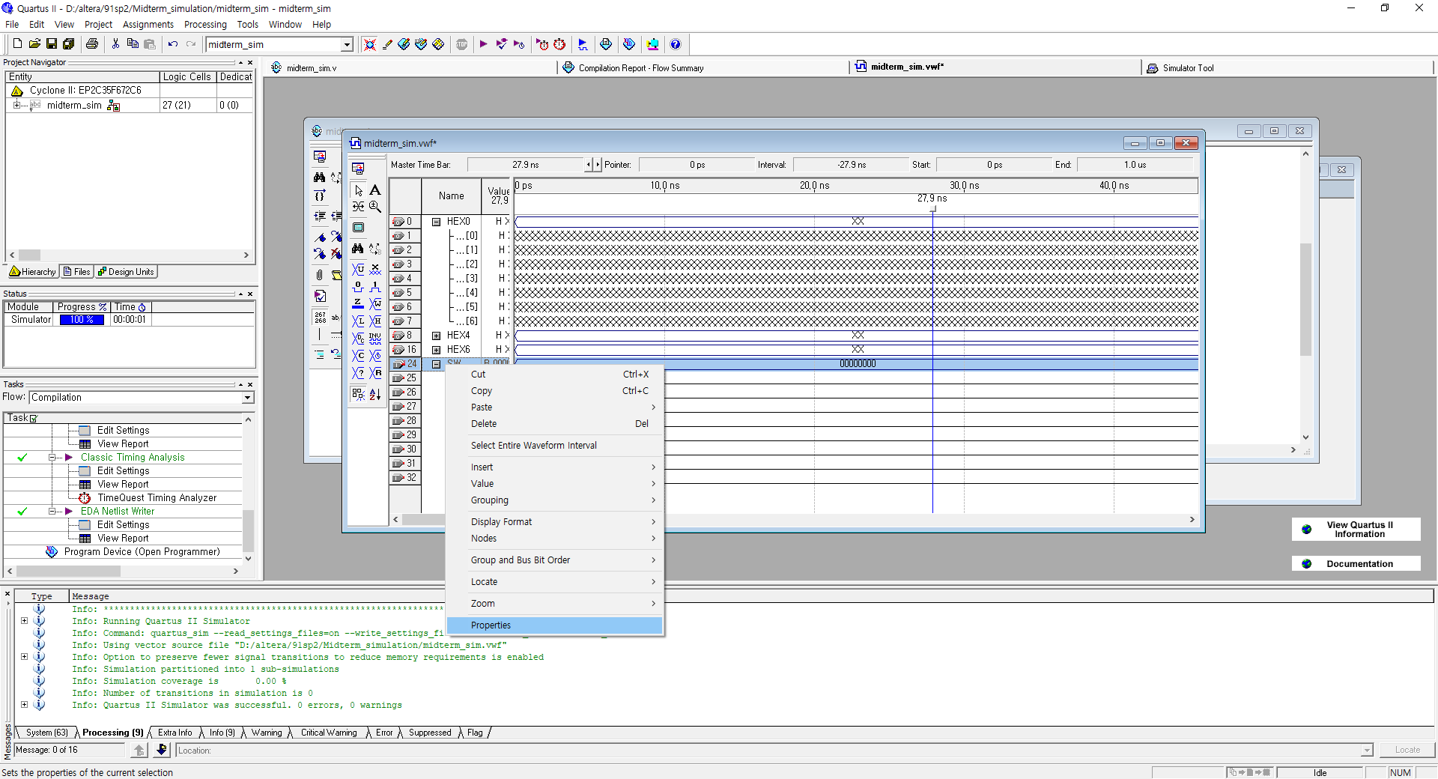
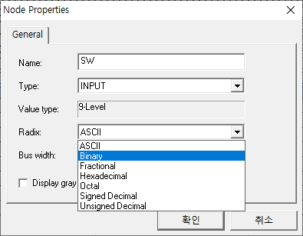
Simulation
If you want to see the binary or hexadecimal, SW -> right mouse -> properties -> change Radix

Slide 21
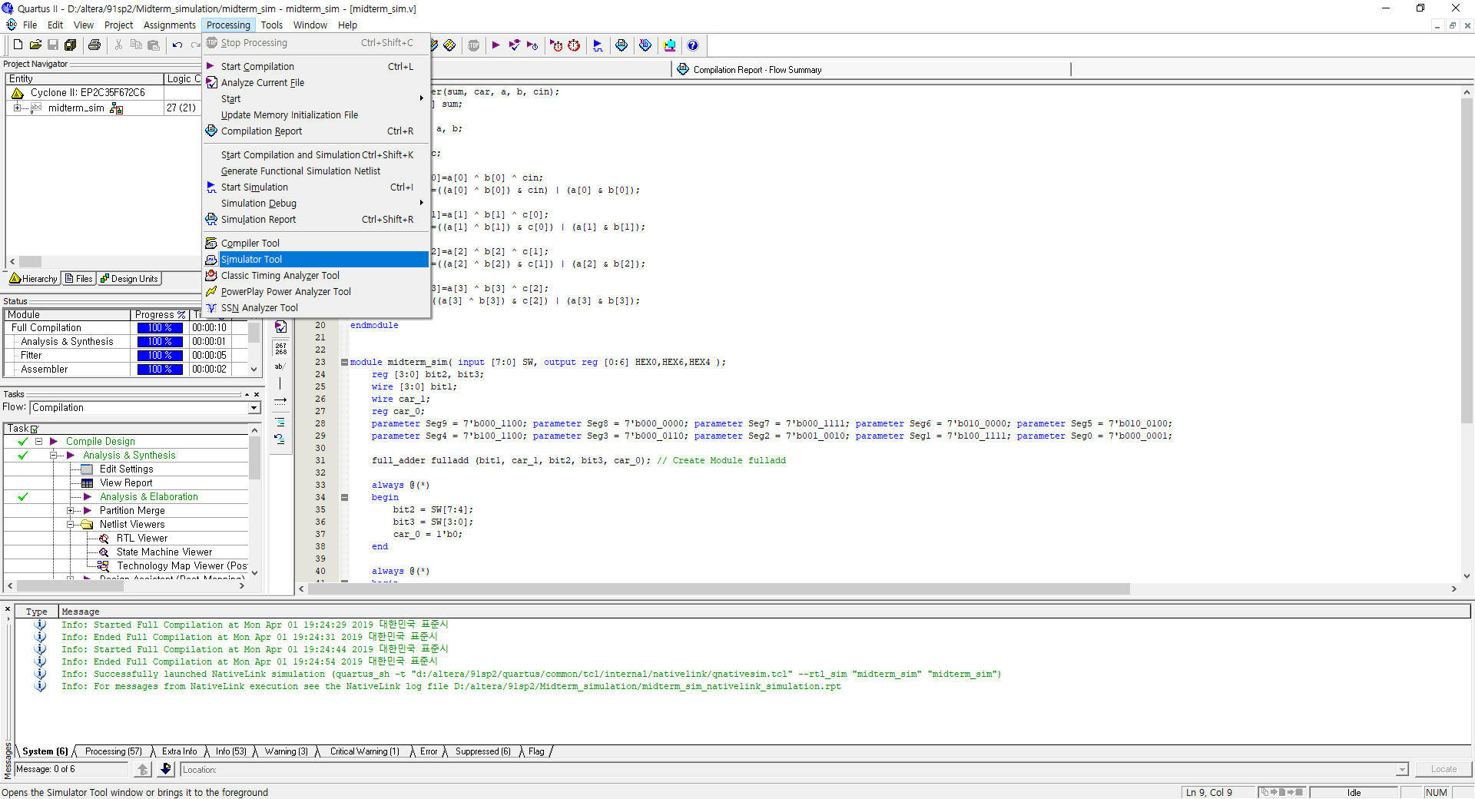
Simulation
Processing -> Simulator Tool -> Find the vwf file -> open

Slide 22
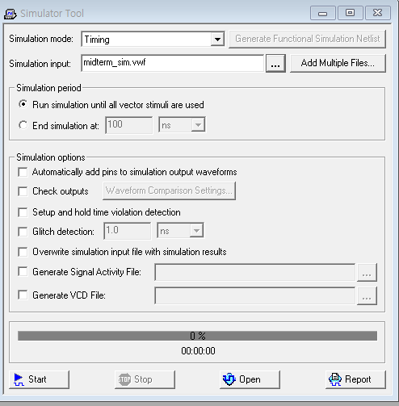
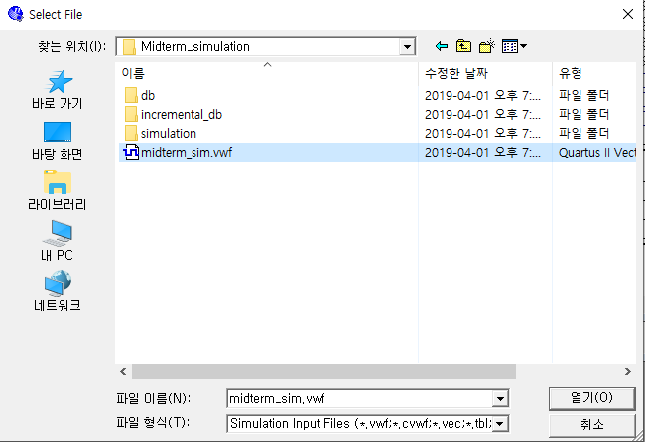
Simulation
Processing -> Simulator Tool -> Find the vwf file -> open

Slide 23
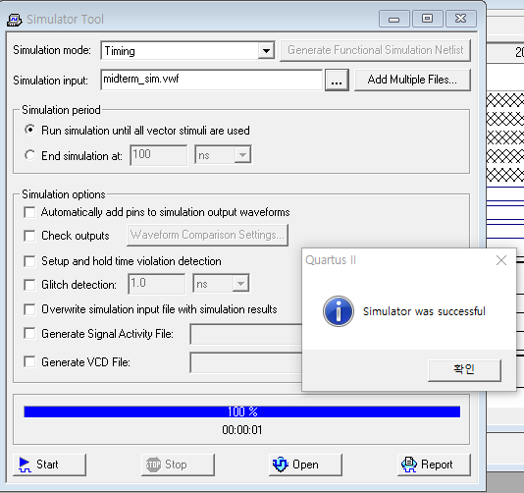
Simulation
Start -> OK -> Report
2
1
3

Slide 24
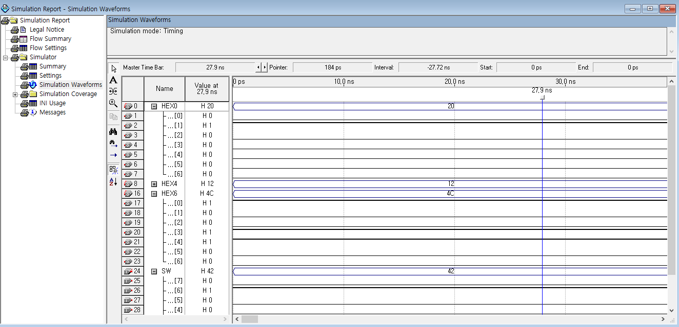
Simulation
Check the Simulation Report
6
4
4+2

Slide 25
Q&A
If you have any question about term project,
please send an e-mail to TA (csh30096@korea.ac.kr)
or use QnA Board in our website
(http://kuld19-1.wixsite.com/kuld)

